Slide 1
Knowledge Representation
Professor Dr. A K M Akhtar Hossain
Dept. of CSE, RU

Slide 2
Knowledge Representation
Knowledge representation (KR) is an important issue in both cognitive science and artificial intelligence.
In cognitive science, it is concerned with the way people store and process information.
In artificial intelligence (AI), main focus is to store knowledge so that programs can process it and achieve human intelligence.

Slide 3
Knowledge Representation
A knowledge representation is most fundamentally a substitute for the thing itself, used to enable an entity to determine consequences by reasoning about the world.
Reasoning is the use of symbolic representations of some statements in order to derive new ones.

Slide 4
Knowledge Acquisition
Information presented in this module is largely summarized from: Jones, P.H. 1989. Knowledge Acquisition. In: Barrett, J.R. and D.D. Jones. Knowledge Engineering in Agriculture. ASAE Monograph No. 8, ASAE, St. Joseph, MI.
Introduction
Knowledge acquisition is the process of extracting, structuring and organizing knowledge from one source, usually human experts, so it can be used in software such as an ES. This is often the major obstacle in building an ES.There are three main topic areas central to knowledge acquisition that require consideration in all ES projects. First, the domain must be evaluated to determine if the type of knowledge in the domain is suitable for an ES. Second, the source of expertise must be identified and evaluated to ensure that the specific level of knowledge required by the project is provided. Third, if the major source of expertise is a person, the specific knowledge acquisition techniques and participants need to be identified.
Theoretical Considerations
An ES attempts to replicate in software the reasoning/pattern-recognition abilities of human experts who are distinctive because of their particular knowledge and specialized intelligence. ES should be heuristic and readily distinguishable from algorithmic programs and databases. Further, ES should be based on expert knowledge, not just competent or skillful behavior.Domains

Slide 5
What is predicate logic (PL)?
Predicate logic also embodies a set of systematic procedures for proving that certain formula can or cannot be logically derived from others and such logical inference procedures have been used as the backbone for problem-solving systems in AI.
A predicate logic is an expression of one or more variables defined on some specific domain. A predicate with variables can be made a proposition by either assigning a value to the variable or by quantifying the variable.

Slide 6
Predicate logic (PL):
A predicate is a statement that contains variables (predicate variables), and they may be true or false depending on the values of these variables.
Predicate logic is the generic term for symbolic formal systems like first-order logic, second-order logic, many-sorted logic, or infinitary logic.

Slide 7
Predicate Logic (PL):
It has three more logical notions as compared to PL.
Terms,
Predicates
Quantifiers
Term
a constant (single individual or concept i.e.,5, john etc.),
a variable that stands for different individuals
n-place function f(t1, …, tn) where t1, …, tn are terms. A function is a mapping that maps n terms to a term.
Predicate
a relation that maps n terms to a truth value true (T) or false (F).
Quantifiers
Universal (∀) or existential(∃) quantifiers i.e. ∀ and ∃ used in conjunction with variables.

Slide 8
Examples
“x loves y” is represented as LOVE(x, y) which maps it to true or false when x and y get instantiated to actual values.
“john’s father loves john” is represented as LOVE(father(john), john).
Here father is a function that maps john to his father.
x is greater than y is represented in predicate calculus as GT(x, y).
It is defined as follows:
GT( x, y) =T , if x > y
=F , otherwise
Symbols like GT and LOVE are called predicates .
Predicates two terms and map to T or F depending upon the values of their terms.

Slide 9
Examples – Cont..
Translate the sentence "Every man is mortal" into Predicate formula.
Representation of statement in predicate form
“x is a man” and “MAN(x),
x is mortal” by MORTAL(x)
Every man is mortal :
(∀x) (MAN(x) → MORTAL(x))
Here, ∀x is read as “for all x” and → is read as “implies”.

Slide 10
****Syntax and semantics for Propositional Logic
Valid statements or sentences in PL(Predicate Logic) are determined according to the rules of propositional syntax.
This syntax governs the combination of basic building blocks such as propositions and logical connectives.
Propositions are elementary atomic sentences.

Slide 11
Limitations of Propositional Logic
Limitation: Propositional Logic does not allow us to conclude the truth of ALL or SOME statements. Hence, some valid arguments cannot be concluded or translated into purely propositional logic. It is not possible to mention properties that apply to categories of object, or even about relationships between those properties. Please read the following examples carefullyExamples
Example 1: Every computer connected to the college network is functioning properly.
Computer Science lab is functioning properly
However, it is not possible to find out the truth about whether Business lab is functioning.
Example 2: Adam is ill.
If Adam is ill, he should not go to school.
So, Adam should not go to school.
Example 3: Computer X has been infected by a virus.
Computer Y has been infected by a virus.
However, it is not possible to say the city network has been infected by virus.
Basically, propositional logic is limited to infer statements from general rules.

Slide 12
Cont……
Propositional Logic may be either true or false but may take on no other value.
Examples (Simple propositions):
It is raining.
It is a shining day.
Snow is white.
Snow is black.
People live on the Earth.
People live on the Moon.

Slide 13
Cont….
Examples (Compound propositions):
It is raining and the wind is blowing.
If you study hard you will be rewarded.
The sum of 10 and 20 is not 40.
The sum of 20 and 10 is 40.
T and F are special symbols having the values true and false.

Slide 14
Conti…
Logical Connectives:
Symbol | Meaning
˜ | for not or negation
& | for and or conjunction
v | For or or disjunction
→ | For if … then or implication
↔ | For if and only if or double implication

Slide 15
Syntax
The syntax of PL is defined recursively as follows:
T and F are formulas.
IF P and Q are formulas, the following are also formulas:
(˜P)
(P&Q)
(PVQ)
(P→Q)
(P↔Q)

Slide 16
Example
Represent the following facts in predicate logic:
(i). All employees earning Tk. 2,50,000/= or more per year have to pay taxes.
∀x ((E(x) & GE(i(x), 250000)) →T(x))
(ii). People only try to assassinate rulers they are not loyal to.
∃y: ∀x : person(x) Ʌ ruler(y) Ʌ tryassassinate(x, y) → ¬loyalto (x, y)
(iii). John likes all kinds of food.
Like (john, all-kinds-of-food)

Slide 17
Assignment-1
Write PL for the following sentences:-
Every elephant is gray.
There is a white alligator.
All students are smart.

Slide 18
Semantics
The semantics or meaning of a sentence is just the value true or false: that is, it is as assignment of a truth value to the sentences.
An interpretation for a sentence or group of sentences in an assignment of the truth value to each propositional symbol.

Slide 19
Conti…
Example: Consider the statement = (P & ~Q)
Clearly, there are four distinct interpretations for this sentences.
Interpretation | P | Q
1 | True | False
2 | True | True
3 | False | True
4 | False | False

Slide 20
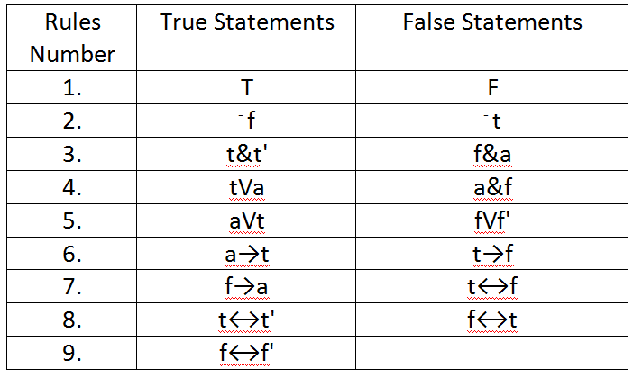
Semantic Rules for statements
Consider t and f' denotes true statements, f and t' denotes false statements, and a is any statement.

Slide 21
Example:
Let I assign true to P , false to Q and false to R in statement ((P & ⁻Q) →R)VQ.
What is the meaning of the statement?
Answer:
Rule 2 gives ⁻Q as true.
Rule 3 gives (P & ⁻Q) as true.
Rule 6 gives (P & ⁻Q) →R as false.
Rule 5 gives the statement ((P & ⁻Q) →R)VQ value as false.

Slide 22
Assignment-2
Find the meaning of the statement
(⁻PVQ)&R→SV(⁻R&Q)
for each of the interpretations given below.
(a). I₁ : P is true, Q is true, R is false, S is true.
(b). I₂ : P is true, Q is false, R is true, S is true.

Slide 23
THE END
THANKS

